Slide 1
CTS 6319 Cyber Security: Measurement and Data Analysis
Dr. Elias Bou-Harb
ebouharb@fau.edu EE 503B
Office hours: Mondays 3-4pm

Slide 2
Material
On Canvas
Research Paper 4:
Cyber Scanning: A Comprehensive Survey

Slide 3
Probing
Activities that is used to search for aliveness, vulnerabilities or ways to infiltrate IT assets
Also known as scanning
A common methodology that is adopted by attackers prior to launching a targeted cyber attack

Slide 4
Probing
Used significantly in Internet measurement studies for benign tasks
Characterizing vulnerabilities
Analyzing system security “in the wild”
Measuring IPv4 allocation
Characterizing open resolvers/reflectors (http://blog.shadowserver.org/2014/03/28/the-scannings-will-continue-until-the-internet-improves/)

Slide 5
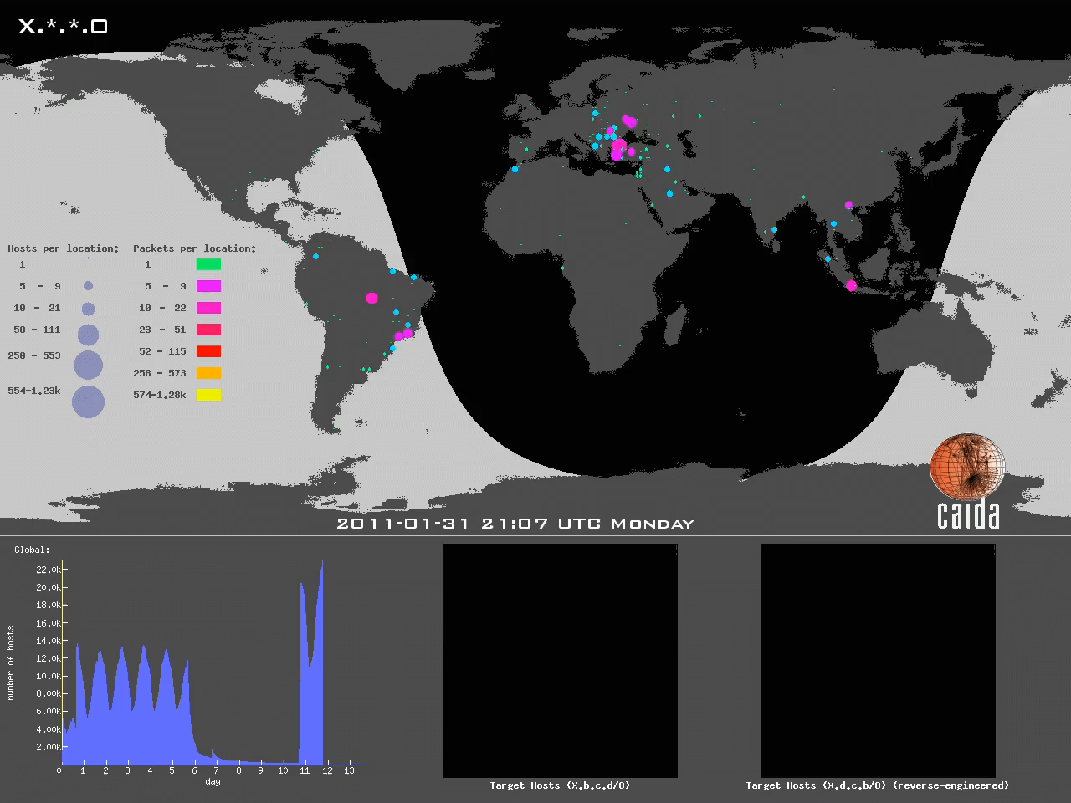
Probing: An example

Slide 6
Probing: Some Tools
OpenSSL Heartbleed vulnerability scanner https://pentest-tools.com/network-vulnerability-scanning/openssl-heartbleed-scanner
https://nmap.org/
Zmap and Zipper Zmap (https://zmap.io/ https://jhalderm.com/pub/papers/zmap10gig-woot14.pdf

Slide 7
Probing: Few Benign Initiatives
University of Michigan performs regular Zmap probing
Ruhr-Universität Bochum completes weekly scans on ports 53, 80, 123, 137, 161
The Shadow Server Open Resolver Scanning Project
Daily ICMP echo request scans from Guangzhou, China

Slide 8
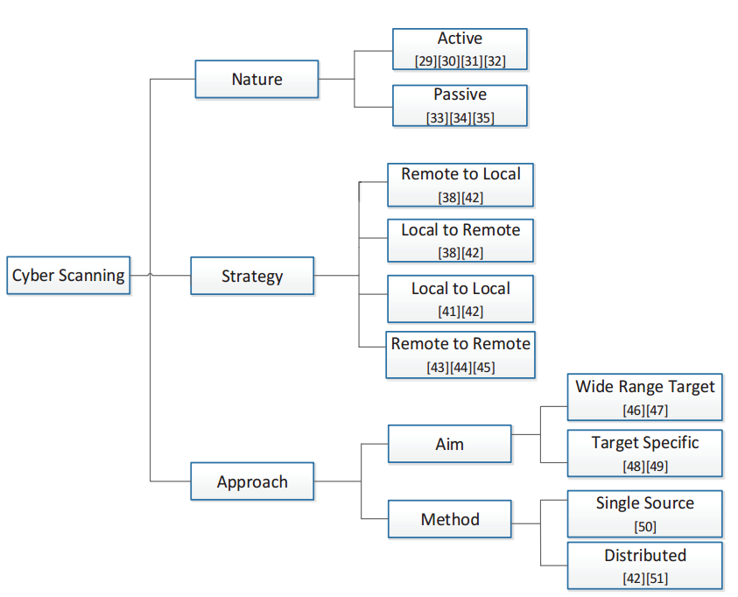
Probing:

Slide 9
Active Probing
Generation of probe packets that can provide some info related to the destination
Could be accomplished using TCP or UDP->Network layer
OS level-> OS fingerprint techniques
Application layer
Positives:
Often provides a comprehensive list of available services
?
Negatives:
Intrusive
Can be detected by IDS
?

Slide 10
Passive Probing
Does not require any generation of traffic
Mostly network forensic investigation approaches
Passive observation of TCP handshakes
Analysis of UDP sessions
Positives:
Stealthy, non-intrusive
?
Negatives:
Only infers services in the dump or if they are active at the time of analysis
?

Slide 11
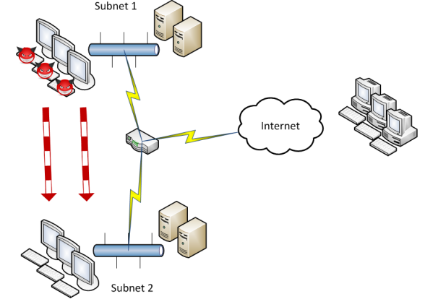
Probing Strategies
Remote to Local
Local to Remote
Local to Local
Remote to remote (probing campaigns)

Slide 12
Probing Approaches
Wide-range probing
Auto-rooters (scan and attack form different hosts)
Scanning worms
Target-specific probing
Indirect scanning (scan and attack form different hosts)
Throw-away scanning
Botnet scanning
Low and slow scanning
Single source probing
Distributed probing

Slide 13
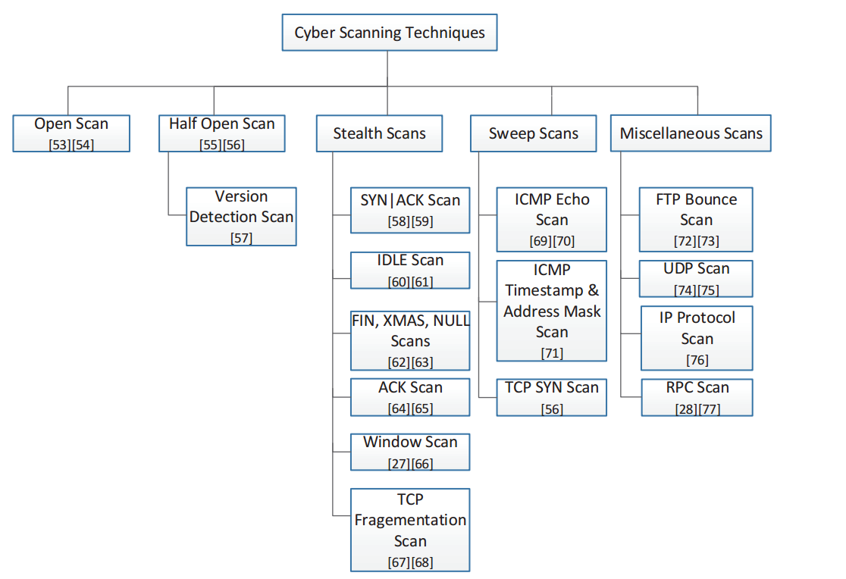
Probing Techniques

Slide 14
Open Scan
Indistinguishable compared with the TCP/IP handshake
Sends TCP SYN packet and completes the communication, in case of an ACK
Otherwise, a RST packet would be a received

Slide 15
Half-Open Scan
An incomplete TCP/IP handshake
Sends TCP SYN packet and does not complete the communication, in case of an ACK
Otherwise, a RST packet would be a received

Slide 16
SYN|ACK Scan
Sends both, SYN and ACK packets
Receives RST for closed port and nothing for open port
The ratio of being fast to detectable is considered to be decent.

Slide 17
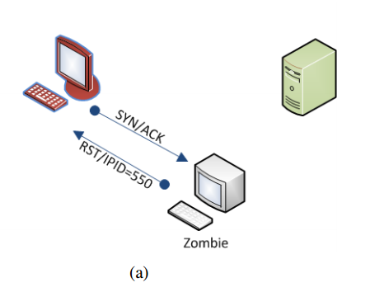
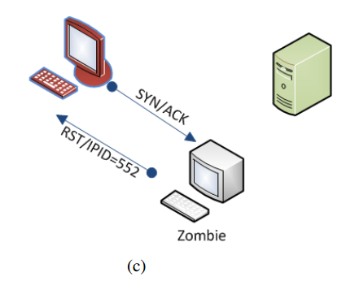
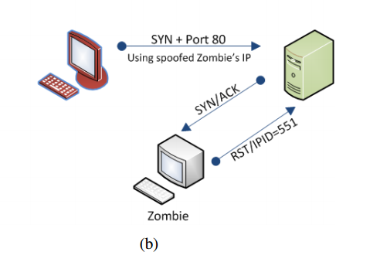
IDLE Scan

Slide 18
FIN, XMAS, NULL Scans
No TCP/IP handshake
Sends FIN, URG, PUSH, and packets with no flags
Receive RST for closed port and nothing for open ports
XMAS Scanning (00101001)
Not effective on windows environments

Slide 19
ACK Scan
Sends TCP ACK
Receives nothing or ICMP destination unreachable for filtered ports
Receives RST for unfiltered ports
Filtered does not mean it’s open/close
Just reached/didn’t reach the destination

Slide 20
Sweep Scans
Aim at identifying active hosts rather the ports
Typically used as a precursor approach to other scanning methods
Example:
ICMP Echo
Embedded in the famous ping utility
Sends ICMP Echo, expects to receive ICMP Reply
Else, destination unreachable or request times out

Slide 21
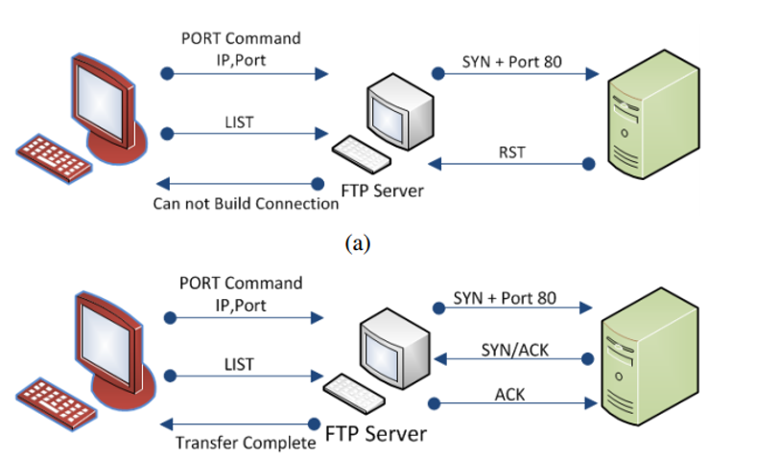
FTP Bounce Scan

Slide 22
UDP Scans
Characteristically, does not employ TCP/IP
Sends UDP packets and expects some data, ICMP port unreachable otherwise

Slide 23
IP Protocol Scan
Only scan that solely leverages the network layer
Aims to identify other protocols on the host
Sends IP Protocols packets, expects some info related to that probed protocol, otherwise nothing will be returned

Slide 24
RPC Scanning
Aims at identifying RPC applications
RPC NULL packets to previously open ports
Application’s name, version and status will be returned , if successful

Slide 25
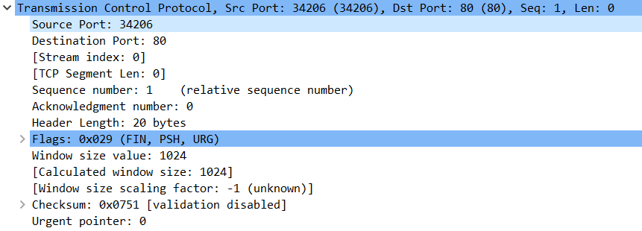
Examples

Slide 26
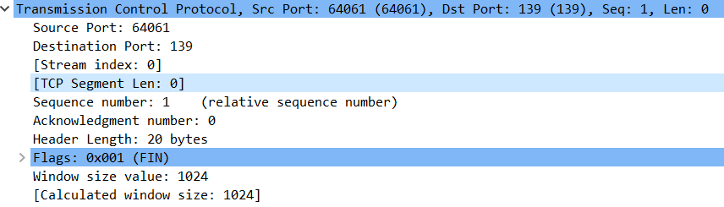
Examples

Slide 27
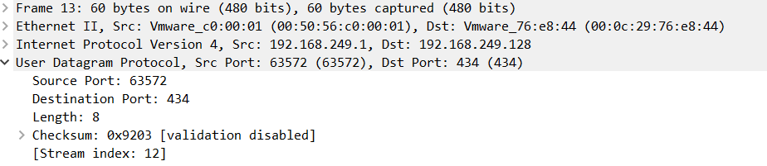
Examples

Slide 28
Labeling Scans
Horizontal Scan
Probe one port across many hosts
Vertical Scan
Probe one host on many ports
Strobe Scan

Slide 29
Case Study Presentation
https://www.dfrws.org/sites/default/files/session-files/pers-multidimensional_investigation_of_source_port_0_probing.pdf

Slide 30
CTS 6319 Cyber Security: Measurement and Data Analysis
ebouharb@fau.edu EE 503B
Office hours: Monday 3-4pm
http://faculty.eng.fau.edu/ebouharb/

